Slide 1
WoT Action Model
Michael Lagally
30 June 2021

Slide 2
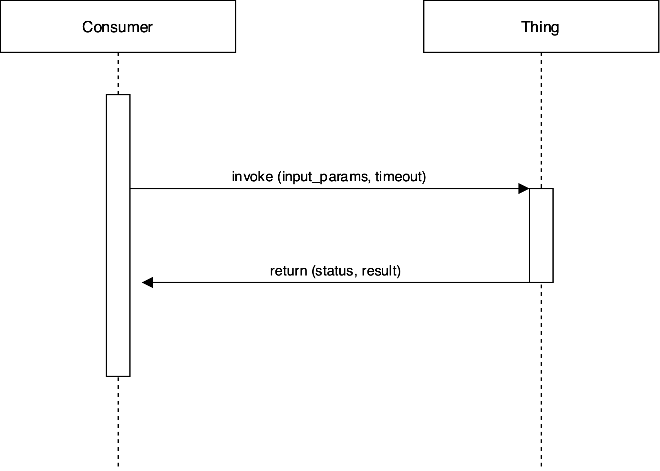
Action ~ Remote Procedure Call

Slide 3
Execution states of an action
received
dispatched
Completed successfully
Timeout expired
failed
unknown

Slide 4
Action status
completed : boolean
id: unique action id
requestTime: - time when the action request has been received
responseTime: - time when the action response has been sent
status: [
"RECEIVED” – action request has been received
"DISPATCHED” – action has been dispatched (e.g. to a subsystem)
"COMPLETED” – action has completed
"EXPIRED” – action is expired
"FAILED” – action has failed
"UNKNOWN" – action status is unknown
]
result: JSON object with the response
statusUrl: query the status of a an action

Slide 5
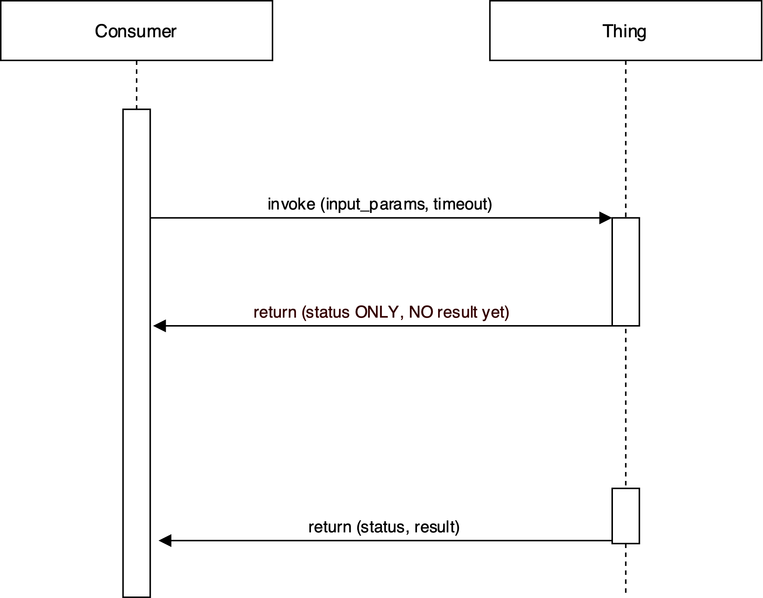
Long running actions

Slide 6
Cancellation of actions
RPCs cannot be cancelled, a remote procedure is atomic.
The TD does not offer an explicit mechanism to cancel an action.
Some long running actions may be conceptually cancellable, this depends on the implementation of the “remote procedure” in the thing.
A generic cancel mechanism introduces complex action semantics.
Significant implementation burden.
Potentially negative interop impact.
If cancelling of actions is required, a dedicated cancel operation can be modeled, the profile can define naming conventions.

Slide 7
Long running actions - how to get the result?
?

Slide 8
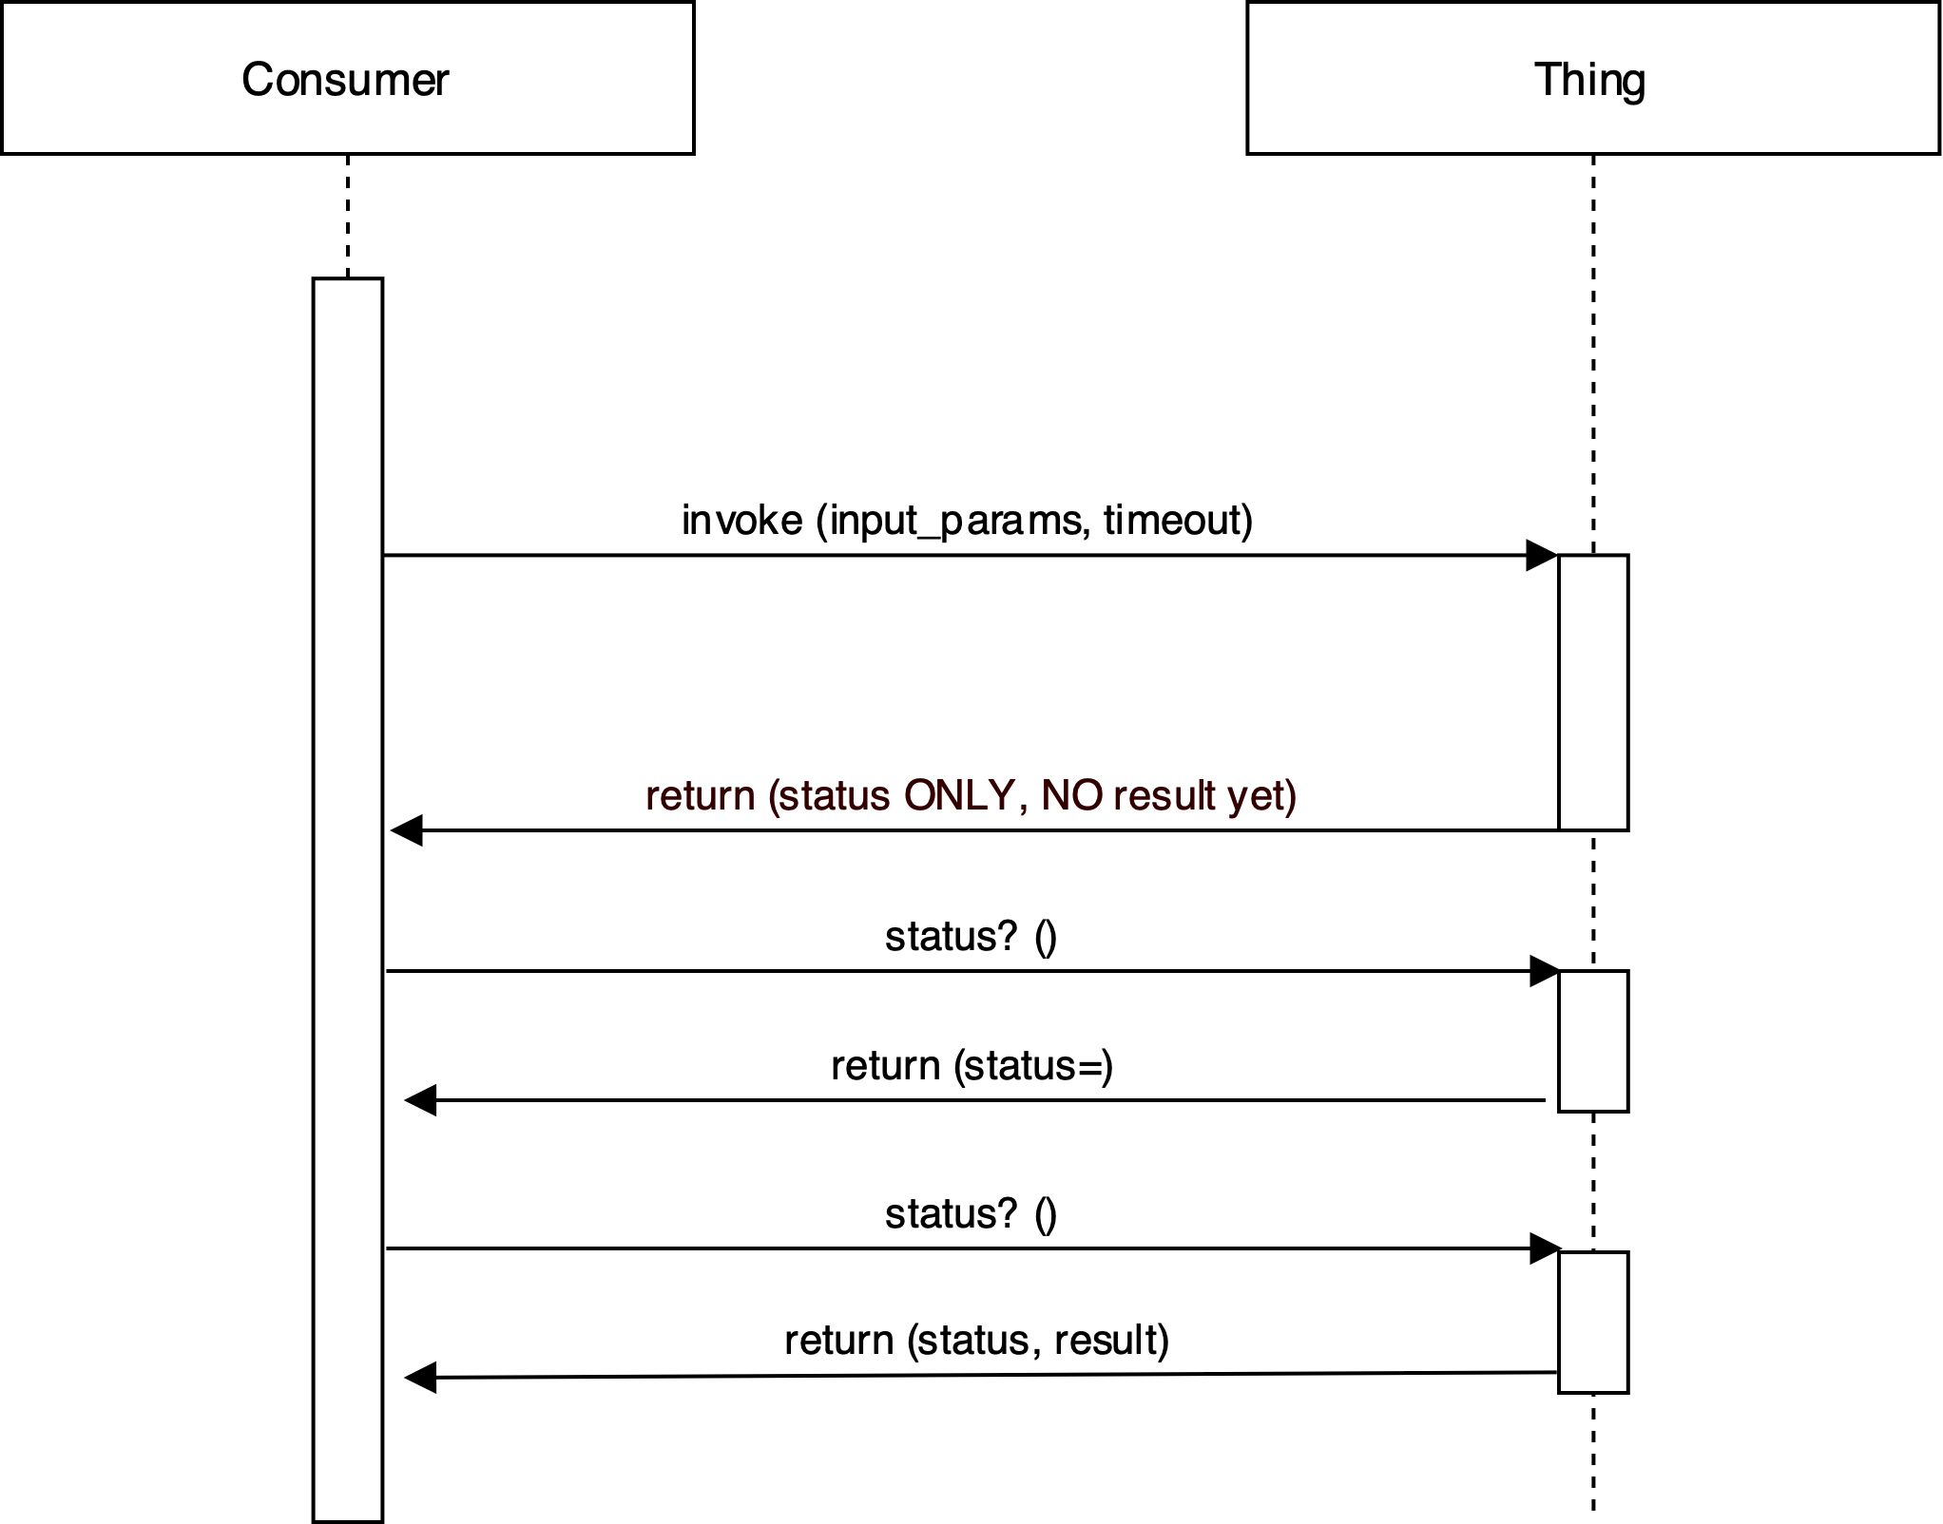
Long running actions - Polling

Slide 9
Long running actions - timeout
XXXXXXXXXXXXXXXXX

Slide 10
Long running actions - how to get the result?
Various event mechanisms: SSE, LongPoll, WebHook, … Can we agree on a standard?

Slide 11
Action queues
Action queues are a list of actions that are processed on a server.
Processing is typically done in FIFO sequence.
The impose a specific implementation model on actions.
Some model limitations, e.g. processing of cancellations, emergency stop.
They go beyond the scope of WoT.

